Slide 1

Recent Nobel Prize Winner: Nobel Prize in Physics 2025
The 2025 Nobel Prize in Physics Unlocks a New Reality
QUANTUM PHYSICS · 2025 NOBEL PRIZE
Notes:
What if the strange 'magic' of the quantum world, like objects passing through walls, could happen right here in our macroscopic world? This year's Nobel Prize in Physics has made this seemingly impossible concept a reality.

Slide 2





Agenda
Core Concept
Current Applications
The Nobel-winning discovery explained.
How it's shaping today's technology.
Ethical Considerations
Conclusion & Call to Action
Opportunities and challenges ahead.
Our shared responsibility.
2025 Nobel Prize in Physics · Quantum Technology Symposium
Notes:
Today, we will explore the groundbreaking discovery of the 2025 Nobel laureates, which bridges the microscopic and macroscopic quantum realms. We'll discuss its core concept, current applications, future implications, and the ethical challenges we must face, before concluding with a call to action.

Slide 3
Hook
How much prize money do Nobel Prize winners receive?
11 million Swedish kronor=834 5260 0000 rmb
Notes:
John Clarke, Michel Devoret, and John Martinis were awarded for demonstrating quantum tunneling and energy quantization in a macroscopic electrical circuit. They showed that a large system, like a circuit you can hold, can behave like a single quantum particle, 'tunneling' through barriers and absorbing energy in discrete steps, just like electrons in an atom.

Slide 4

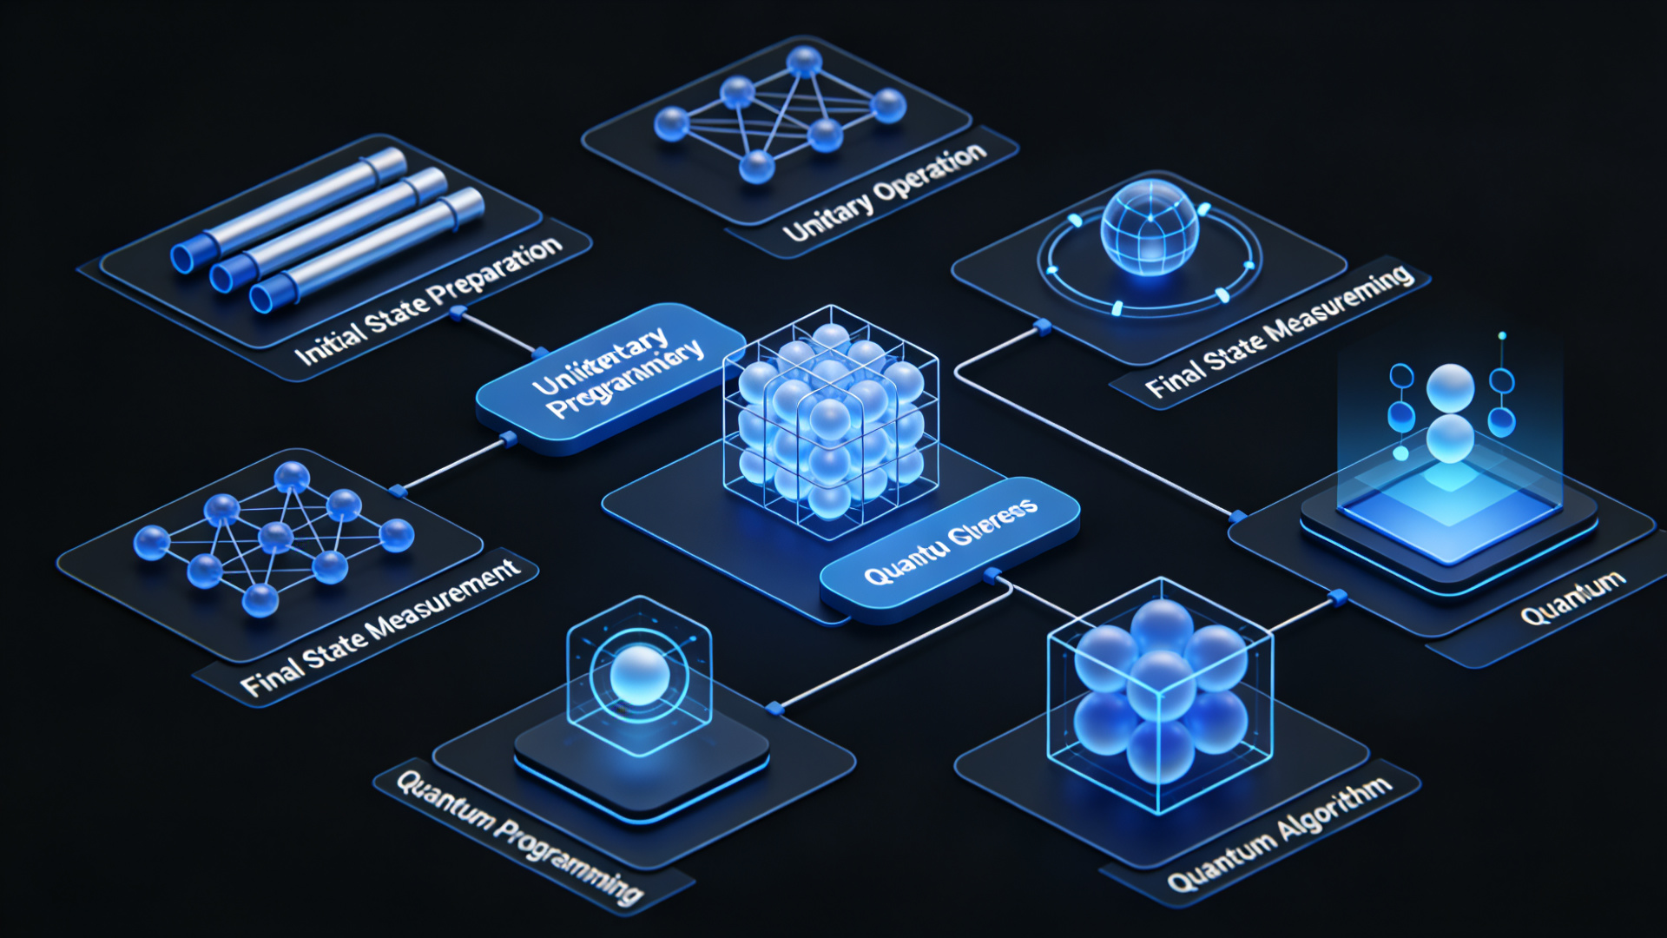

Core Concept: Macroscopic Quantum Effects
Laureates
John Clarke, Michel H. Devoret, John M. Martinis
Discovery
They demonstratedquantum tunnelingandenergy quantizationin a macroscopic electrical circuit.
Significance
This proves that quantum behavior isn't limited to the tiny world of atoms, but can exist in systems large enough to see and touch.
Visualization of Quantum Computing Process
Notes:
John Clarke, Michel Devoret, and John Martinis were awarded for demonstrating quantum tunneling and energy quantization in a macroscopic electrical circuit. They showed that a large system, like a circuit you can hold, can behave like a single quantum particle, 'tunneling' through barriers and absorbing energy in discrete steps, just like electrons in an atom.

Slide 5
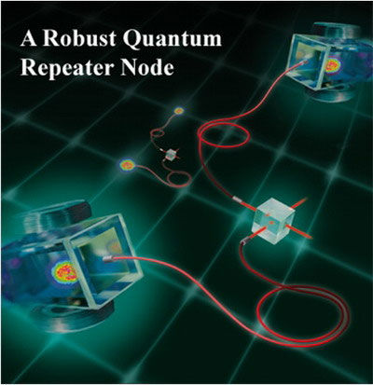
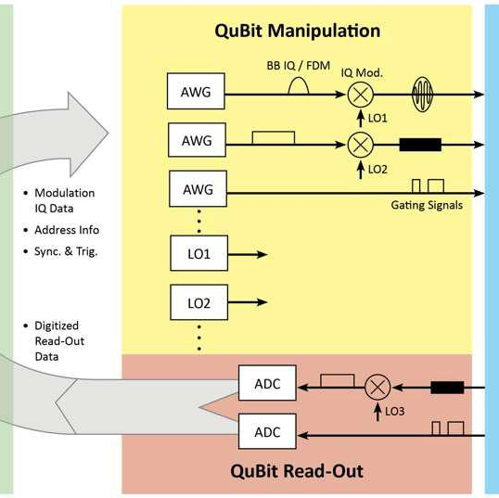
Current Relevance & Applications
Quantum Computing
Quantum Cryptography
Quantum Sensors
Building the next generation of supercomputers to solve complex problems beyond classical limits.
Creating unhackable communication networks for ultimate security by leveraging quantum principles.
Enabling ultra-precise measurements in medicine, navigation, and fundamental scientific research.
Notes:
This discovery is the foundation for next-generation quantum technologies. It enables the development of powerful quantum computers that can solve problems classical computers cannot, ultra-secure quantum communication that detects any eavesdropping, and ultra-precise quantum sensors for medicine and exploration.

Slide 6



Future Implications & Ethical Considerations
Hype vs. Reality
Avoid over-promising and focus on solid research to maintain credibility in the field.
Security Risks
Quantum computing could break current encryption standards, demanding new security protocols.
Social Equity
Ensure the benefits of quantum tech are accessible to all, bridging the digital divide.
Navigating the quantum revolution responsibly for a sustainable future.
Notes:
While promising, quantum technology also brings challenges. We must guard against over-hyping and ensure research remains pure. There are also risks to data security, as quantum computers could break current encryption, and we need to ensure the benefits of this technology are shared equitably across society.

Slide 7



Conclusion & Call to Action
Conclusion
The 2025 Nobel Prize is a giant leap forward in our understanding of the quantum world, opening new frontiers for technology and humanity.
Next Steps: Call to Action
Support Fundamental Research
Invest in quantum science to unlock its full potential for future generations.
Establish Ethical Guidelines
Create frameworks to ensure responsible development and application of quantum tech.
Foster Public Understanding
Educate the public to bridge the knowledge gap and build trust in new technologies.
Notes:
The journey to the stars begins with every step of exploration. This Nobel Prize-winning discovery is a giant leap.
To harness its potential, we must take three key actions: invest in basic research to fuel innovation, establish ethical guidelines to ensure we use this power wisely, and educate the public to foster understanding.
Together, we can ensure quantum technology benefits all of humanity.

Slide 8


In normal physics, a ball can’t climb over a hill if it doesn’t have enough energy.
In quantum physics, tiny particles can "tunnel" right through barriers—even when they don’t have the energy to go over them.
In normal physics, a ball can’t climb over a hill if it doesn’t have enough energy.
In quantum physics, tiny particles can "tunnel" right through barriers—even when they don’t have the energy to go over them.
Scientists built a big superconducting circuit that showed quantum tunneling.
This proved quantum rules work not just for tiny particles, but for larger systems too.
Deep Dive: What is Quantum Tunneling?
Classical vs. Quantum
In normal physics, a ball can’t climb over a hill if it doesn’t have enough energy.
In quantum physics, tiny particles can "tunnel" right through barriers—even when they don’t have the energy to go over them.
The Nobel-Winning Experiment
Scientists built a big superconducting circuit that showed quantum tunneling.
This proved quantum rules work not just for tiny particles, but for larger systems too.
Quantum Tunneling Visualization
Notes:
To understand their discovery, let's take a closer look at quantum tunneling. Imagine a ball rolling towards a hill. In our everyday, classical world, if the ball doesn't have enough speed, it can't get over the hill. But in the quantum world, particles like electrons have a strange property: they can sometimes pass through the hill, even without the energy to climb it. This is quantum tunneling. What the Nobel laureates did was create a large electrical circuit that showed this exact behavior, proving that the weird rules of quantum physics apply to things we can actually see and hold.

Slide 9



Making new drugs means simulating how molecules work together.
Classical computers are too slow—this can take years.
This speeds up treatments for Alzheimer’s, cancer, and superbugs.
It could save millions of lives.
Case Study: Quantum Computing in Drug Discovery
The Computational Challenge (Problem)
Making new drugs means simulating how molecules work together. • Classical computers are too slow—this can take years.
Quantum Advantage (Solution)
Quantum computers do this work much faster. • They can cut drug discovery time from years to just months.
Transforming Healthcare (Impact)
This speeds up treatments for Alzheimer’s, cancer, and superbugs. • It could save millions of lives.
Molecular Simulation Visualization
Notes:
Let's look at a concrete example of how quantum computing is changing the world: drug discovery. Developing a new medicine involves figuring out how different molecules interact with each other, which is an incredibly complex problem for classical computers. It can take years to simulate just one potential drug. But quantum computers excel at these kinds of complex simulations. They can model molecular interactions much faster, potentially cutting the time to discover life-saving drugs from years down to just months. This is not just about faster computers; it's about accelerating medical breakthroughs that could save millions of lives.

Slide 10



Deeper Ethical Challenges
Geopolitical Competition
Job Displacement
False information and controlling people
Countries are racing to build quantum tech. • This could spark a new arms race or let one nation dominate, making global security less stable.
Quantum computers will automate work now done by humans. • Many jobs in finance, logistics, and software development could be lost.
Quantum AI can make hyper-realistic fake videos and false information at a huge scale. • This threatens democracy and social stability.
Notes:
Beyond the immediate challenges, we must also consider deeper ethical implications. The race to develop quantum technology is already becoming a geopolitical competition, which could lead to a new era of tension. Additionally, just as AI and automation are changing the job market, quantum computing could automate even more complex tasks, leading to significant job displacement. Finally, when combined with AI, quantum technology could enable the creation of hyper-realistic fake videos and audio, making it harder than ever to distinguish truth from fiction, and posing a serious threat to our societies.

Slide 11


Thank You
Any Questions?
Notes:
Thank you for your attention. I'm happy to take any questions.

